Slide 1

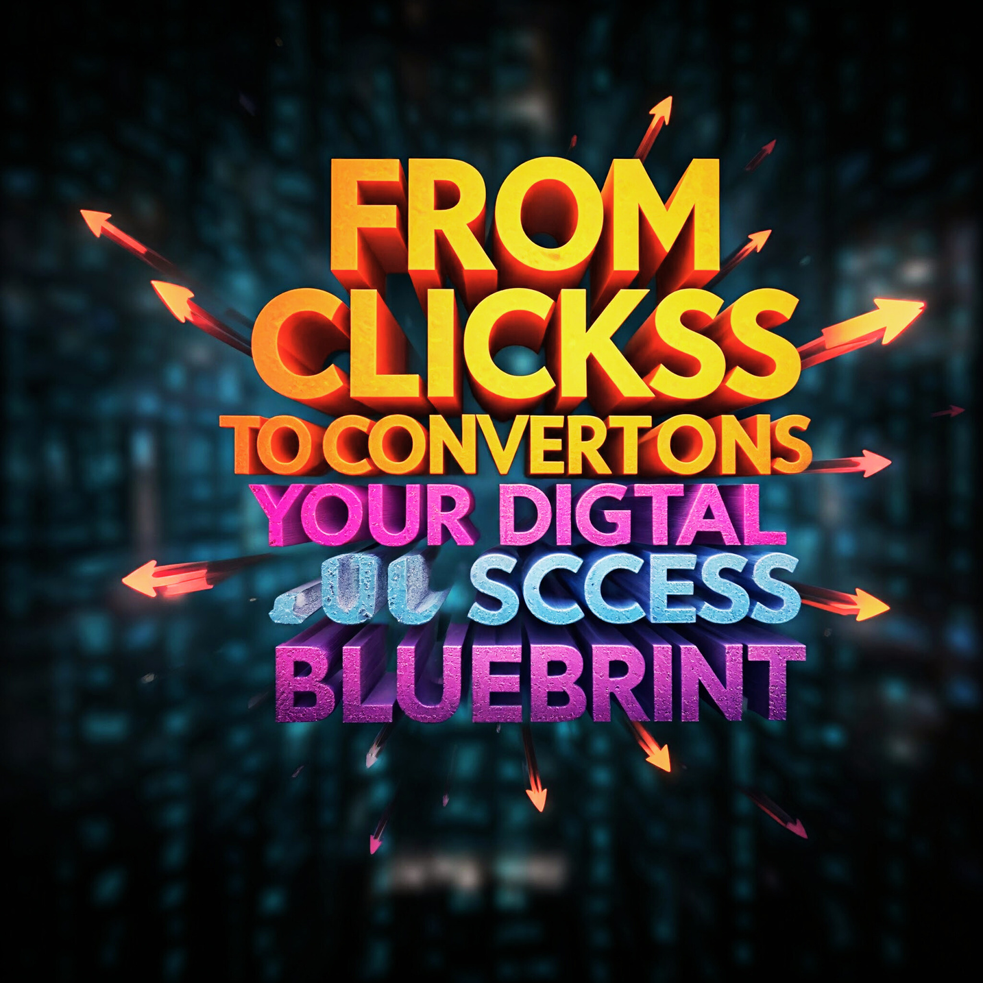
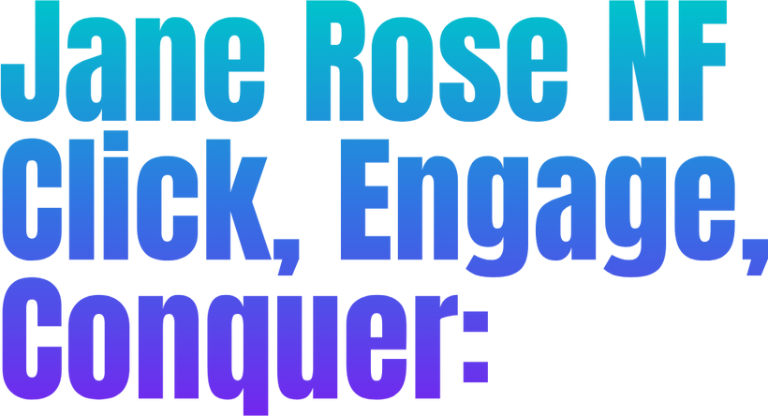


Presented by:
YOUR PARAGRAPH TEXT
1

Slide 2
WHAT IS DIGITAL MARKETING?
DEFINITION: THE PROMOTION OF
PRODUCTS OR BRANDS VIA
ELECTRONIC MEDIA
BORCELLE
MARKETING PLAN
Presented by:
Jonathan Patterson
2

Slide 3
KEY CHANNELS:
SEARCH ENGINE OPTIMIZATION (SEO)
PAY-PER-CLICK (PPC) ADVERTISING
SOCIAL MEDIA MARKETING
BORCELLE
MARKETING PLAN
Presented by:
Jonathan Patterson
3

Slide 4
CONTENT MARKETING
EMAIL MARKETING
MOBILE MARKETING
AFFILIATE MARKETING
INFLUENCER MARKETING
BORCELLE
MARKETING PLAN
Presented by:
Jonathan Patterson
4

Slide 5

LEVEL UP YOUR DIGITAL GAME
5

Slide 6


WHY DIGITAL MARKETING?
REACH A WIDER AUDIENCE:
CONNECT WITH A GLOBAL AUDIENCE.
6

Slide 7
COST-EFFECTIVE:
OFTEN MORE AFFORDABLE
THAN TRADITIONAL MARKETING.
7

Slide 8
MEASURABLE RESULTS:
TRACK AND ANALYZE THE
EFFECTIVENESS OF YOUR
CAMPAIGNS.
8

Slide 9
TARGETED MARKETING:
REACH SPECIFIC
DEMOGRAPHICS AND INTERESTS.
9

Slide 10
ENHANCED CUSTOMER ENGAGEMENT:
INTERACT WITH YOUR
AUDIENCE IN REAL-TIME.
10

Slide 11
IMPROVED BRAND REPUTATION:
BUILD A STRONG BRAND
REPUTATION ONLINE.
11

Slide 12

12

Slide 13

THE DIGITAL MARKETING FUNNEL
Awareness: Attract POTENTIAL CUSTOMERS THROUGH VARIOUS CHANNELS.
13

Slide 14
INTEREST:
GENERATE INTEREST
IN YOUR PRODUCTS
OR SERVICES.
14

Slide 15
DESIRE:
PERSUADE POTENTIAL CUSTOMERS TO CONSIDER YOUR OFFERINGS.
15

Slide 16
ACTION:
CONVERT POTENTIAL CUSTOMERS INTO ACTUAL CUSTOMERS.
16

Slide 17
LOYALTY:
FOSTER LONG-TERM RELATIONSHIPS WITH CUSTOMERS.
17

Slide 18

18

Slide 19

KEY PERFORMANCE INDICATORS (KPIS) IN DIGITAL MARKETING
19

Slide 20
WEBSITE TRAFFIC:
MEASURE THE NUMBER OF VISITORS TO YOUR WEBSITE.
20

Slide 21
ENGAGEMENT RATE:
TRACK LIKES, SHARES, COMMENTS, AND CLICKS.
21

Slide 22
CONVERSION RATE: MEASURE THE PERCENTAGE OF VISITORS WHO TAKE A DESIRED ACTION (E.G., PURCHASE, SIGN-UP).
22

Slide 23
RETURN ON INVESTMENT (ROI): CALCULATE THE RETURN ON YOUR MARKETING INVESTMENT.
23

Slide 24

24

Slide 25

SEARCH ENGINE OPTIMIZATION (SEO)
25

Slide 26
WHAT IS SEO? THE PROCESS OF OPTIMIZING YOUR WEBSITE TO RANK HIGHER IN SEARCH ENGINE RESULTS.
26

Slide 27
ON-PAGE SEO: OPTIMIZING WEBSITE CONTENT, INCLUDING TITLES, META DESCRIPTIONS, AND HEADERS.
27

Slide 28
OFF-PAGE SEO: BUILDING BACKLINKS AND IMPROVING WEBSITE AUTHORITY.
28

Slide 29
TECHNICAL SEO: ENSURING YOUR WEBSITE IS TECHNICALLY SOUND FOR SEARCH ENGINES.
29

Slide 30

30

Slide 31

PAY-PER-CLICK (PPC) ADVERTISING
31

Slide 32
WHAT IS PPC? A DIGITAL ADVERTISING MODEL WHERE ADVERTISERS PAY A FEE EACH TIME THEIR AD IS CLICKED.
32

Slide 33
GOOGLE ADS: CREATE AND MANAGE TEXT, DISPLAY, AND VIDEO ADS ON GOOGLE.
SOCIAL MEDIA
33

Slide 34
ADVERTISING: USE PLATFORMS LIKE FACEBOOK, INSTAGRAM, AND LINKEDIN TO TARGET SPECIFIC AUDIENCES.
34

Slide 35
REMARKETING: RETARGET USERS WHO HAVE VISITED YOUR WEBSITE BUT HAVEN'T CONVERTED
35

Slide 36

36

Slide 37

CONTENT MARKETING
37

Slide 38
WHAT IS CONTENT MARKETING? CREATING AND SHARING VALUABLE CONTENT TO ATTRACT AND RETAIN A CLEARLY DEFINED AUDIENCE.
38

Slide 39
CONTENT CREATION: DEVELOP BLOG POSTS, ARTICLES, VIDEOS, INFOGRAPHICS, AND OTHER CONTENT FORMATS.
39

Slide 40
CONTENT DISTRIBUTION: SHARE CONTENT ON SOCIAL MEDIA, EMAIL, AND OTHER CHANNELS.
40

Slide 41
CONTENT PROMOTION: USE SEO, SOCIAL MEDIA, AND PAID ADVERTISING TO PROMOTE CONTENT.
41

Slide 42


TRANSFORM YOUR
BUSINESS
DIGITALLY
42

Slide 43

SOCIAL MEDIA MARKETING
43

Slide 44
PLATFORM SELECTION: CHOOSE THE RIGHT PLATFORMS FOR YOUR TARGET AUDIENCE.
44

Slide 45
CONTENT STRATEGY: CREATE ENGAGING CONTENT AND A CONSISTENT POSTING SCHEDULE.
45

Slide 46
COMMUNITY BUILDING: INTERACT WITH YOUR AUDIENCE AND RESPOND TO COMMENTS AND MESSAGES.
46

Slide 47
SOCIAL MEDIA ADVERTISING: USE PAID ADVERTISING TO REACH A WIDER AUDIENCE.
47

Slide 48
Email Marketing
48

Slide 49
Build an Email List: Collect email addresses through website forms, pop-ups, and social media.
v
49

Slide 50
Create Engaging Email Campaigns: Design attractive emails with compelling subject lines and content.
50

Slide 51
Personalize Your Emails: Tailor your emails to individual preferences.
51

Slide 52
Track Email Performance: Monitor open rates, click-through rates, and conversion rates.
52

Slide 53
Mobile Marketing
53

Slide 54
Mobile Website Optimization: Ensure your website is mobile-friendly.
54

Slide 55
Mobile App Development: Develop a mobile app to enhance user experience.
55

Slide 56
SMS Marketing: Send targeted text messages to your audience.
56

Slide 57
Mobile Advertising: Use mobile ads to reach users on their smartphones and tablets.
57

Slide 58

Affiliate Marketing
58

Slide 59
What is Affiliate Marketing?
A performance-based marketing strategy where you earn a commission by promoting other people's products or services.
59

Slide 60
Affiliate Programs: Join affiliate programs to promote products and earn commissions.
60

Slide 61
Affiliate Marketing Strategies: Use content marketing, email marketing, and social media to promote affiliate products.
61

Slide 62

Influencer Marketing
Identify Influencers: Find influencers who align with your brand and target audience.
62

Slide 63
Collaborate with Influencers:
Partner with influencers to promote your products or services.
63

Slide 64
Measure Influencer Marketing Campaigns:
Track the impact of influencer campaigns on brand awareness and sales.
z
64

Slide 65
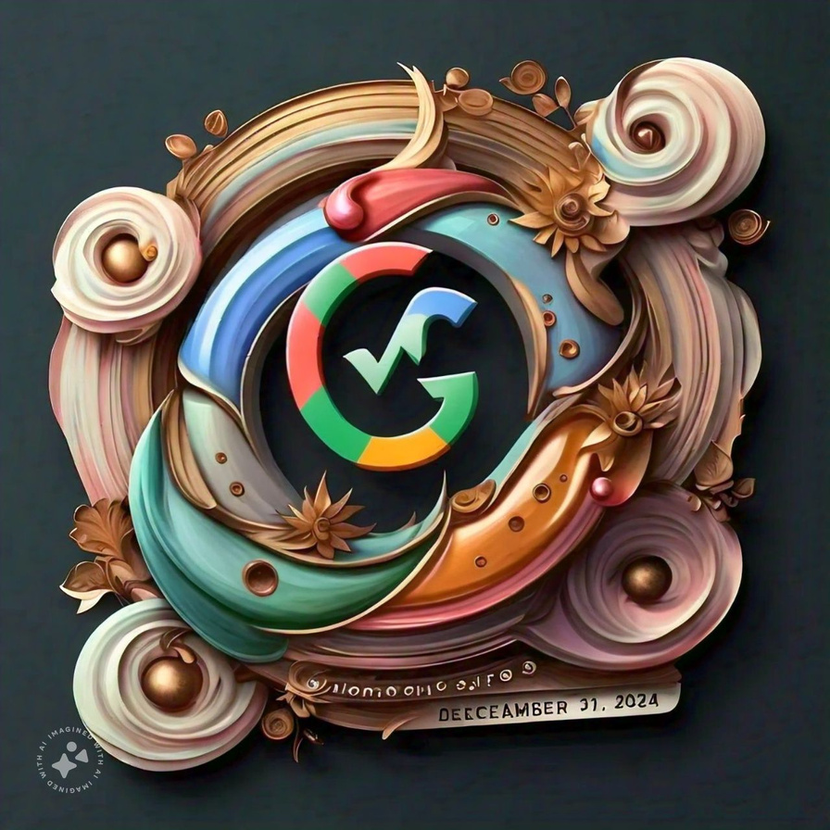
Google Analytics:
65

Slide 66
Track website traffic, user behavior, and conversions.

Slide 67
Social Media Analytics: Monitor social media metrics like engagement, reach, and click-through rates.
67

Slide 68
Email Marketing Analytics: Track email open rates, click-through rates, and conversion rates.
68

Slide 69
PPC Analytics: Analyze the performance of your PPC campaigns.
69

Slide 70

The Future of Digital Marketing
70

Slide 71

Artificial Intelligence (AI): AI-powered tools for personalized marketing and automation.
71

Slide 72
Voice Search: Optimize your content for voice search queries.
72

Slide 73
Augmented Reality (AR) and Virtual Reality (VR): Immersive experiences for customers.
73

Slide 74
Internet of Things (IoT): Market to connected devices and their users.
74

Slide 75

z
Ethical Considerations in Digital Marketing
75

Slide 76

z
Transparency: Be transparent about your marketing practices.
76

Slide 77
Misleading Advertising: Avoid deceptive advertising practices.
z
77

Slide 78
Spam: Avoid spamming users with unsolicited emails or messages.
z
78

Slide 79
Fairness: Treat all customers fairly and avoid discriminatory practices.
z
79

Slide 80


Challenges in
Digital Marketing
80

Slide 81
Staying Updated: Keep up with the latest trends and technologies.
81

Slide 82
Measuring ROI: Quantifying the impact of digital marketing efforts.
82

Slide 83
Building Trust and Credibility: Establishing a strong brand reputation.
83

Slide 84
Dealing with Ad Blockers: Finding ways to reach users who use ad blockers.
84

Slide 85
Adapting to Mobile: Optimizing your website and marketing efforts for mobile devices.
85

Slide 86


86

Slide 87
Conclusion
87

Slide 88
Recap Key Points:
88

Slide 89
Call to Action: Encourage the audience to take action, such as visiting your website, signing up for your newsletter, or contacting you.
89

Slide 90
Q&A Session: Open the floor for questions and discussions.
z
90

